Slide 1
Basic HTML Elements
Introduction to HTML Elements | Paragraphs | White spaces and Line breaks | Sections and Headings | Text Formating |
Notes:
Welcome to our lecture on Basic HTML elements. In this lecture we will go through the html elements, and some html tags like paragraphs, how to deal with white spaces and break lines, sections and headings in html, and text formatting tags in html. So let’s start.

Slide 2

Introduction to HTML Elements
HTML elements are the basic building blocks of a webpage, used to structure and present content.
Each element is defined using tags enclosed in angle brackets, like <p> for paragraphs.
An element typically consists of an opening tag, content, and a closing tag, e.g., <h1>Hello</h1>.
Notes:
So, the HTML elements are the basic building blocks of a webpage. They help structure and present content effectively. Each element is defined using tags enclosed in angle brackets, such as p for paragraphs. A typical HTML element includes an opening tag, the content, and a closing tag. For example, Hello inside h1 tag represents a heading. These components are essential for building a well-organized webpage.

Slide 3
Introduction to HTML Elements
Elements can be nested within other elements to create complex web layouts.
Common examples include headings, paragraphs, links, images, and lists.
Notes:
Elements can be nested within other elements, allowing us to build complex web layouts step by step. For instance, you’ll often work with headings to organize content, paragraphs for text, links for navigation, images for visuals, and lists to present information clearly. These are the essential tools for structuring any webpage.

Slide 4
Paragraphs
<p> element creates a paragraph in HTML.
Enclosed by <p> (opening) and </p> (closing) tags.
Browsers add spacing above and below paragraphs.
Errors: Forgetting </p> or nesting <p> inside another <p>.
HTML validator flags nested <p> as an error despite correct rendering.
Notes:
Let's discuss the paragraph element in HTML. The p element creates a paragraph and is enclosed by an opening p tag and a closing back slash p tag. Browsers automatically add spacing above and below paragraphs for clarity. Common errors include forgetting the closing tag or nesting paragraphs inside each other. Although nested p tags may render correctly, an HTML validator will flag them as errors.

Slide 5
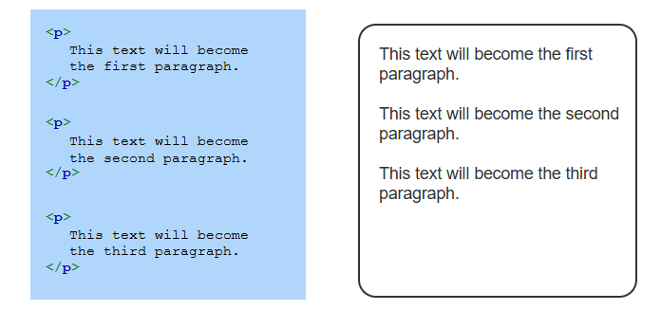
Sample Code for Paragraphs
Notes:
This sample code is illustrating raw text in HTML is displayed as one block of continuous text. A paragraph is surrounded by opening and closing tags. Additional paragraph tags may be added to generate new paragraphs.

Slide 6
Whitespace and line breaks
Whitespace characters include spaces, tabs, and newlines.
Browsers collapse multiple whitespace into a single space.
Example: "hello there" → "hello there".
Notes:
Now move on to the whitespace and line breaks are important aspects of HTML formatting. Whitespace characters include spaces, tabs, and newlines. However, browsers automatically collapse multiple whitespace characters into a single space. For example, if you write hello there with extra spaces, the browser will render it as hello there. Understanding this helps you control spacing effectively in web design.

Slide 7
Whitespace and line breaks
<br> element creates a line break and is a void element (no closing tag).
Use <br> for essential breaks (e.g., poems, addresses), not for spacing.
CSS should be used for webpage formatting.
Notes:
The br element creates a line break and is considered a void element, meaning it does not have a closing tag. You should use the br element only for essential breaks, such as in poems or addresses, rather than for general spacing. For overall webpage formatting, it is better to rely on CSS. This ensures cleaner and more maintainable code while separating structure from styling.

Slide 8
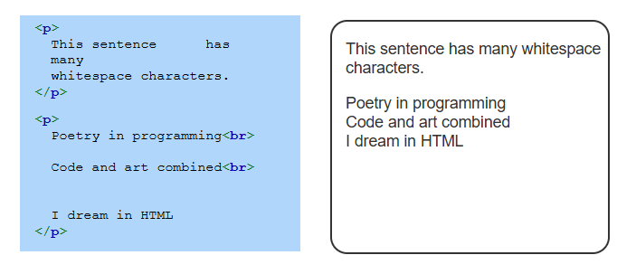
Sample Code for Paragraphs
Notes:
Here is an example of how to structure paragraphs in HTML. Notice the use of the p tag to create separate paragraphs. The br tag is used within a paragraph for line breaks, as seen in the poetry example. While extra spaces are included in the code, browsers ignore them when rendering, ensuring the content appears clean. Properly formatting paragraphs enhances readability and maintains structure.

Slide 9
Sections and headings
<section> element groups related content.
Example: Abstract, intro, main content, and references in a scholarly article.
Headings (<h1> to <h6>) title sections and are bold with extra spacing.
Headings aid skimming, screen readers, and SEO.
Best practice: Use headings based on content structure, not font size.
Notes:
Now move to the section element which are used to group related content, such as abstracts, introductions, main content, or references in a scholarly article. Headings, ranging from h1 to h6, are used to title sections and are styled bold with extra spacing. They improve skimming, assist screen readers, and enhance SEO. Best practice is to use headings based on content structure rather than relying on them for font size adjustments.

Slide 10
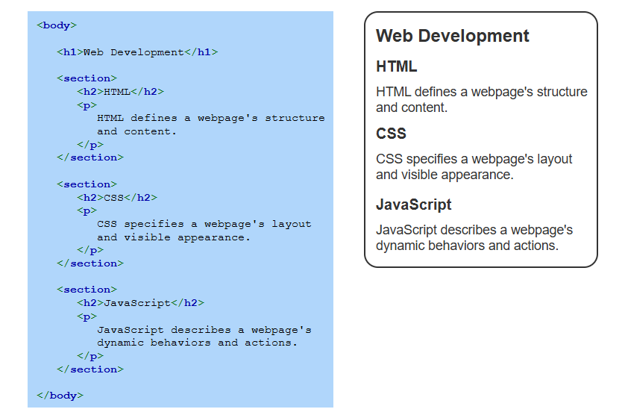
Sample Code
Notes:
This sample code illustrates that webpage usually has a single h1 heading. The heading is visually separated from other text by extra spacing and is displayed with a larger font. Each section starts with an h2 heading, which has a smaller font than the h1 heading.

Slide 11
Text Formatting
<em>: Emphasized text, italicized.
<strong>: Important text, bolded.
<cite>: Titles (books, songs), italicized.
<mark>: Highlighted text, yellow background.
Notes:
Finally discuss the HTML tags for text formatting. The em tag is used for emphasized text, typically displayed in italics. The strong tag highlights important text by bolding it. The cite tag is used for titles of works like books or songs, shown in italics. Lastly, the mark tag highlights text with a yellow background. These tags help improve readability and convey the intended emphasis in your content.

Slide 12
Text Formatting
<b>: Attention text, bolded.
<i>: Alternative voice (foreign words), italicized.
<u>: Different text (e.g., misspellings), underlined.
Notes:
The b tag is used to bold text, drawing attention to important content. The i tag is applied for alternative voices, such as foreign words, and is displayed in italics. The u tag underlines text, often used to highlight different text like misspellings. These tags help style text for clarity, emphasis, or special meaning in your webpage content.

Slide 13
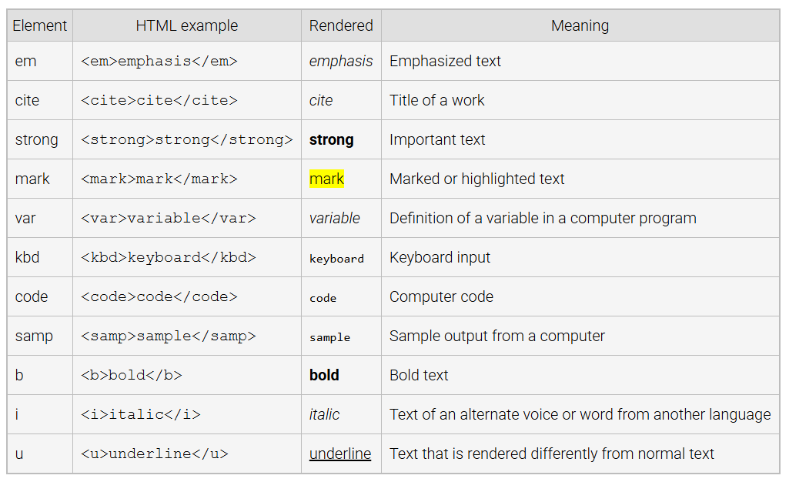
Text Formatting Elements
Notes:
Here is a table with various HTML text formatting elements. The EM tag emphasizes text, usually italicized. The cite tag is for titles of works like books. The strong tag bolds important text, while the mark tag highlights text with a yellow background. The var tag defines variables, and the KBD tag indicates keyboard input. The code and samp tags display code and its output. Finally, b, i, and u tags bold, italicize, and underline text. Thanks for watching the lecture.

